Slide 1
Employee Data Analysis using Excel
STUDENT NAME: NISHAATH FATHIMA.N
REGISTER NO: 312209777,29B0297AD8C50CAAA89418CBEA10E6E9
DEPARTMENT: BCOM-COMPUTER APPLICATION
COLLEGE : ANNA ADARSH COLLEGE FOR WOMEN

Slide 2
PROJECT TITLE
Employee Performance and Stability using Excel

Slide 3


AGENDA
Problem Statement
Project Overview
End Users
Our Solution and Proposition
Dataset Description
Modelling Approach
Results and Discussion
Conclusion
3/21/2024 Annual Review

Slide 4

PROBLEM STATEMENT
The objective of this analysis is to assess employee performance based on various metrics such as productivity, quality of work, punctuality, and adherence to company policies.
The goal is to identify top performers, those who need improvement, and underlying patterns that can help in decision-making for promotions, training, or other HR interventions

Slide 5

PROJECT OVERVIEW
Productivity: Measure output relative to time and expectations.
Quality of Work: Assess error rates, rework requirements, and quality of deliverables
Attendance & Punctuality: Track days worked, tardiness, and leave records.
Peer Feedback: Evaluate collaboration, teamwork, and peer assessments.
Policy Compliance: Monitor adherence to company policies and any disciplinary actions.
.

Slide 6

WHO ARE THE END USERS?
Employee
2.Customer
3.Client
4.General public
5.Stakeholders
6.Business partners
7. Patient

Slide 7

OUR SOLUTION AND ITS VALUE PROPOSITION
1.Performance Scorecards: Individual and departmental performance scorecards.
2.Trend Analysis Reports: Reports highlighting performance trends over time Using pivot table , charts , etc.
3.Actionable Insights: Recommendations for employee development, rewards, and interventions.
4.Visual Dashboards: Interactive Excel dashboards for easy data interpretation.

Slide 8
Dataset Description
1.Employee ID
2. Productivity Data (e.g., number of tasks completed per week/month)
3.Quality Metrics (e.g., error rate, customer feedback scores of employee )
4.Attendance Records (e.g., number of days late, number of leaves taken)
5.Feedback Scores (e.g., peer ratings, supervisor evaluations)
6.Compliance Data (e.g., policy violations, disciplinary actions)
7. Job role
8. Department
9. Staffs

Slide 9

THE "WOW" IN OUR SOLUTION
Identification of high-performing employees for potential rewards or promotions.
Recognition of employees needing further training or development.
Improved understanding of factors contributing to employee performance
3/21/2024 Annual Review
9

Slide 10
MODELLING
Weighted Score Model:
assign weights to different performance metrics based on their importance.
Calculate a weighted score for each employee. For example:
Excel Copy code
* Weighted scores = (KPI Score * 0.4)
Ranking Model:
Rank employees based on their performance scores using Excel’s RANK function.
Example: =RANK(Weighted_Score, $Weighted_Score_Column$
10

Slide 11
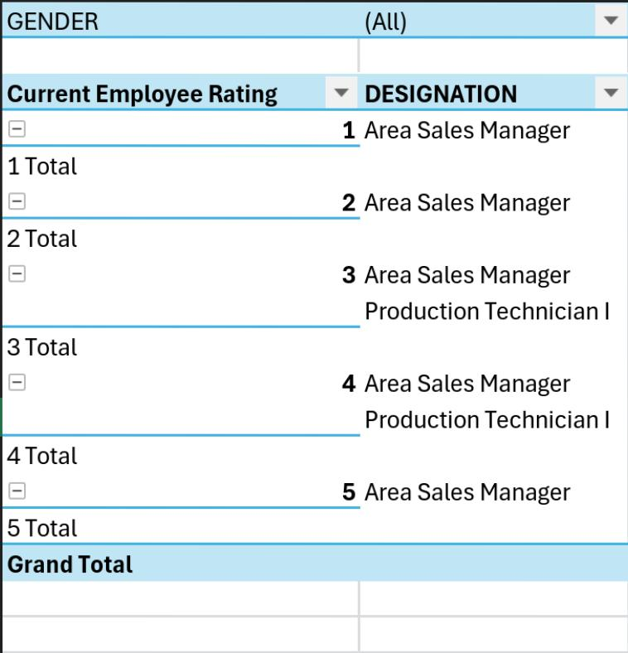
RESULTS
11

Slide 12
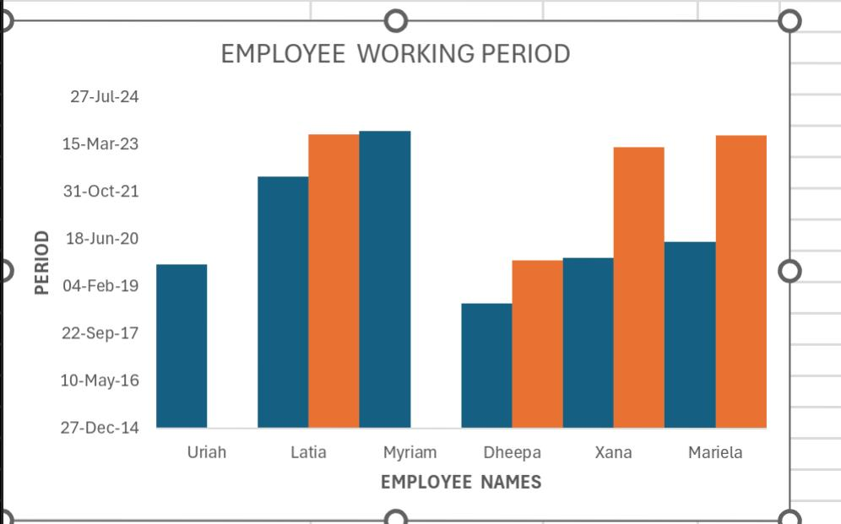
RESULT 2

Slide 13
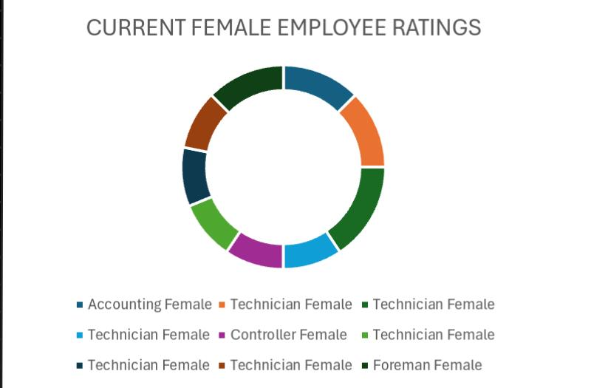
RESULT 3

Slide 14
conclusion
The Excel-based employee performance analysis provides a structured and quantitative approach to evaluating workforce effectiveness.
With clear insights and data-driven recommendations, organizations can make informed decisions to improve overall performance, reward excellence, and address areas of improvement.

